Slide 1
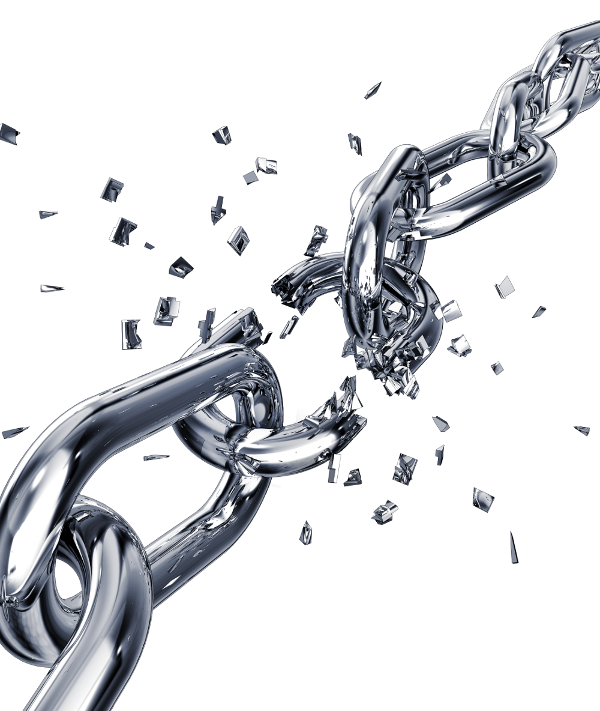
The Word of God is Not Chained!
2 Timothy 2:9
Notes:
(2 Timothy 2:8-10), “Remember that Jesus Christ, of the seed of David, was raised from the dead according to my gospel, ⁹ for which I suffer trouble as an evildoer, even to the point of chains; but the word of God is not chained. ¹⁰ Therefore I endure all things for the sake of the elect, that they also may obtain the salvation which is in Christ Jesus with eternal glory.
Though Paul found himself often in chains, and hindered from his work, he took courage in the fact that God's word cannot be so fettered.
There are many ways in which this is true… For Example:

Slide 2
The Word of God is not Chained!
In its Relevance
Rom. 1:16; 2 Tim. 4:2; Matt. 4:4; Rom. 10:17
Notes:
Because the basic needs of men have not changed
Men still need salvation & the gospel reveals it
(Romans 1:16), “For I am not ashamed of the gospel of Christ, for it is the power of God to salvation for everyone who believes, for the Jew first and also for the Greek.”
Men still need reproof, rebuke, & exhortation from the word
(2 Timothy 4:2), “Preach the word! Be ready in season and out of season. Convince, rebuke, exhort, with all longsuffering and teaching.”
Men still need to know how to live & the Bible tells them
(Matthew 4:4), “But He answered and said, " It is written, 'Man shall not live by bread alone, but by every word that proceeds from the mouth of God. ‘”
Men still need faith & it comes from the word of God
(Romans 10:17), “So then faith comes by hearing, and hearing by the word of God.”
Because of its source
To say that God could not give an ever-relevant word reflects on His power and wisdom
To say that God could but would not reflects on His integrity
If you believe in a wise, powerful and loving God, you are compelled to accept the relevancy of His word.

Slide 3
The Word of God is not Chained!
In its Relevance
Rom. 1:16; 2 Tim. 4:2; Matt. 4:4; Rom. 10:17
In its Power
Rom. 1:16; Mk. 16:15-16; Acts 2:38; 1 Thess. 2:13
Notes:
Is still God's power to save sinners
(Romans 1:16), ““For I am not ashamed of the gospel of Christ, for it is the power of God to salvation for everyone who believes, for the Jew first and also for the Greek.”
Is able to make believer of unbeliever
(Mark 16:15-16), “And He said to them, " Go into all the world and preach the gospel to every creature. 16 He who believes and is baptized will be saved; but he who does not believe will be condemned.”
Is able to bring the rebellious to repentance
(Acts 2:38), NOTE: 3000 souls that day repented and were baptized!
Still works in believers
(1 Thessalonians 2:13), “For this reason we also thank God without ceasing, because when you received the word of God which you heard from us, you welcomed it not as the word of men, but as it is in truth, the word of God, which also effectively works in you who believe.”
Still able to build up
(Acts 20:32), “So now, brethren, I commend you to God and to the word of His grace, which is able to build you up and give you an inheritance among all those who are sanctified.”

Slide 4
The Word of God is not Chained!
In its Relevance
Rom. 1:16; 2 Tim. 4:2; Matt. 4:4; Rom. 10:17
In its Power
Rom. 1:16; Mk. 16:15-16; Acts 2:38; 1 Thess. 2:13
In its Sufficiency
2 Tim. 3:17; 2 Pet. 1:2-3
Notes:
Sufficient to make man all God would have him be
(2 Timothy 3:17), [nothing more needed], ““that the man of God may be complete, thoroughly equipped for every good work.”
Gives us all things pertaining to life and godliness
(2 Peter 1:2-3), “Grace and peace be multiplied to you in the knowledge of God and of Jesus our Lord, ³ as His divine power has given to us all things that pertain to life and godliness, through the knowledge of Him who called us by glory and virtue.”
Never needs revision, amending, up-dating
Everything added or deleted in religion is man's apology for God's work.

Slide 5
The Word of God is not Chained!
In its Relevance
Rom. 1:16; 2 Tim. 4:2; Matt. 4:4; Rom. 10:17
In its Power
Rom. 1:16; Mk. 16:15-16; Acts 2:38; 1 Thess. 2:13
In its Sufficiency
2 Tim. 3:17; 2 Pet. 1:2-3
In its Judgment
John 12:48; Rom. 2:16
Notes:
The standard of right by which all will be measured
(John 12:48), “He who rejects Me, and does not receive My words, has that which judges him—the word that I have spoken will judge him in the last day.”
(Romans 2:16), [in the day of Judgment…], “God will judge the secrets of men by Jesus Christ, according to my gospel.”
The Word is not bound by good intentions, doctrines & traditions of men, feelings or opinions.

Slide 6
Conclusion
Only you are capable of hindering the power and progress of God’s Word!
Notes:
The only sense in which God's word can be bound is in man's rejection of it
Not allowing it free course
(2 Thessalonians 3:1), “Finally, brethren, pray for us, that the word of the Lord may run swiftly and be glorified, just as it is with you.”
It is veiled to them that perish
(2 Corinthians 4:3-4), “But even if our gospel is veiled, it is veiled to those who are perishing, ⁴ whose minds the god of this age has blinded, who do not believe, lest the light of the gospel of the glory of Christ, who is the image of God, should shine on them.”
We must not make the mistake of so binding it...

